Slide 1



AI WEBSITE DESIGN
PROJECT PRESENTATION

Slide 2




INTRODUCTION
Prompt Engineering for Web Design is the process of creating clear, structured, and effective instructions that guide an Artificial Intelligence (AI) system to produce useful web design results.
AI tools can help a web designer:
• Generate HTML
• Generate CSS
• Generate JavaScript
• Create website layouts
• Design user interfaces
• Generate website content
• Create images and graphics
• Improve existing designs
• Make websites responsive

Slide 3
INTRODUCTION
• Debug code
• Explain code
• Generate database structures
• Generate API code
• Improve SEO
• Test website usability
• Convert ideas into complete website prototypes
However, the quality of the result depends heavily on the quality of the instructions given to the AI.
This leads to an important principle:
Better prompts generally produce better and more controllable results.
Prompt engineering therefore becomes an important skill for modern web designers.

Slide 4


What Is a Prompt
A prompt is an instruction, question, command, or description given to an AI system to produce a desired result.
For example:
“Create a website for a restaurant.”
This is a prompt, but it is very general.
A more detailed prompt could be:
“Create a modern responsive restaurant website using HTML5,
CSS3 and Bootstrap 5.”

Slide 5
What Is a Prompt
The website should include:
- Responsive navigation bar
- Hero section
- About section
- Menu section
- Customer testimonials
- Contact form
- Google Maps section
- Footer
Use a professional restaurant design with warm colors,
large food images, rounded cards and clear call-to-action
buttons.
Make the website responsive on mobile, tablet and desktop.
The second prompt gives the AI much more information to work with.

Slide 6


What Is Prompt Engineering
Prompt engineering is the practice of designing and refining prompts to obtain accurate, useful, consistent, and controllable AI-generated results.
It is not simply asking AI questions.
It involves understanding:
What you want
How to describe it
What technology should be used
What constraints exist
What output format you need
What the user experience should be
What should and should not be included
For web design, prompt engineering allows you to communicate your design requirements to AI in a structured way.

Slide 7

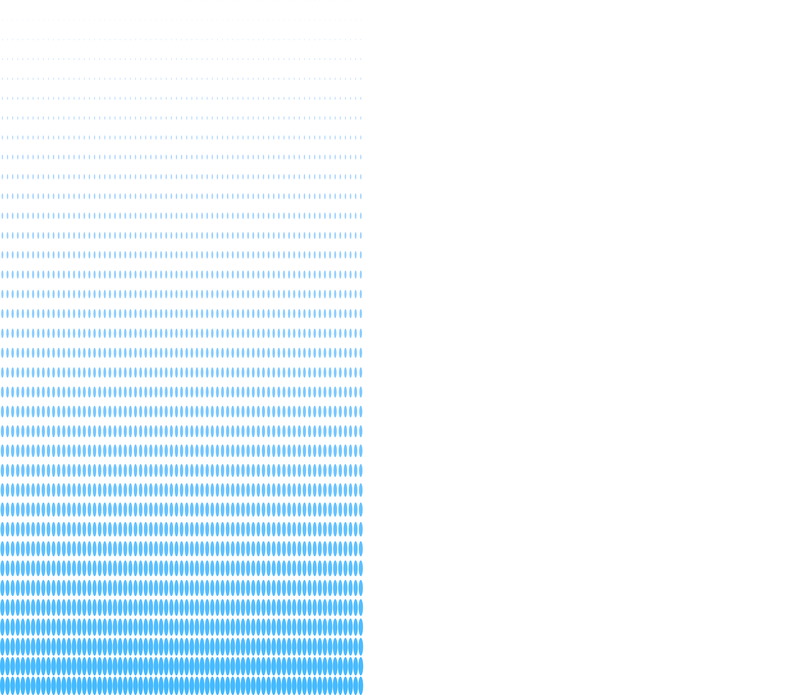
Why Prompt Engineering Is Important in Web Design
Traditional web development requires the designer/developer to manually create many parts of a website.
With AI assistance, many tasks can be accelerated.
For example:
Idea
↓
AI Prompt
↓
AI Output
↓
Review
↓
Modify
↓
Test
↓
Final Website

Slide 8
Why Prompt Engineering Is Important in Web Design
Without a good prompt:
Vague prompt
↓
Poor output
↓
Many corrections
↓
Wasted time
With a good prompt:
Detailed prompt
↓
Relevant output
↓
Small corrections
↓
Faster development

Slide 9
Prompt Engineering Does Not Replace Web Design Knowledge
This is extremely important.
AI can generate code, but a web designer should understand what the code is doing.
For example, AI may generate:
.container {
display: flex;
justify-content: space-between;
}
The designer should understand:
What display: flex does
What justify-content does
When Flexbox should be used
How it behaves on mobile
Whether the layout is appropriate
Therefore:
AI should be treated as an assistant, not as a replacement for web design knowledge.

Slide 10

Components of a Good Web Design Prompt
A good web design prompt can contain several important components.
A useful structure is:
ROLE
+
TASK
+
PROJECT CONTEXT
+
TECHNOLOGY
+
DESIGN REQUIREMENTS
+
FUNCTIONAL REQUIREMENTS
+
RESPONSIVENESS
+
CONSTRAINTS
+
OUTPUT FORMAT

Slide 11
Components of a Good Web Design Prompt
For example:
Act as a professional UI/UX designer and frontend developer.
Create a modern landing page for a digital payment platform.
Technology:
- HTML5
- CSS3
- Bootstrap 5
JavaScript
Design:
- Modern
- Professional
- Clean
- Mobile-first
- Minimal

Slide 12
Components of a Good Web Design Prompt
Sections:
- Navbar
- Hero
- Services
- Features
- Testimonials
- FAQ
- CTA
- Footer
The website must be responsive on mobile, tablet and desktop.
Return the complete HTML, CSS and JavaScript code.

Slide 13

The Role in a Prompt
A role tells the AI what type of expert you want it to behave like.
For example:
Act as a professional web designer.
Or:
Act as a senior frontend developer.
Or:
Act as a UI/UX designer specializing in modern SaaS websites.
Or:
Act as a senior Bootstrap developer.

Slide 14
The Role in a Prompt
Why roles are useful
A role provides context.
Compare:
Create a dashboard.
with:
Act as a senior UI/UX designer and frontend developer.
Design a professional admin dashboard for an e-commerce platform.
The second prompt establishes the expected expertise and context.

Slide 15
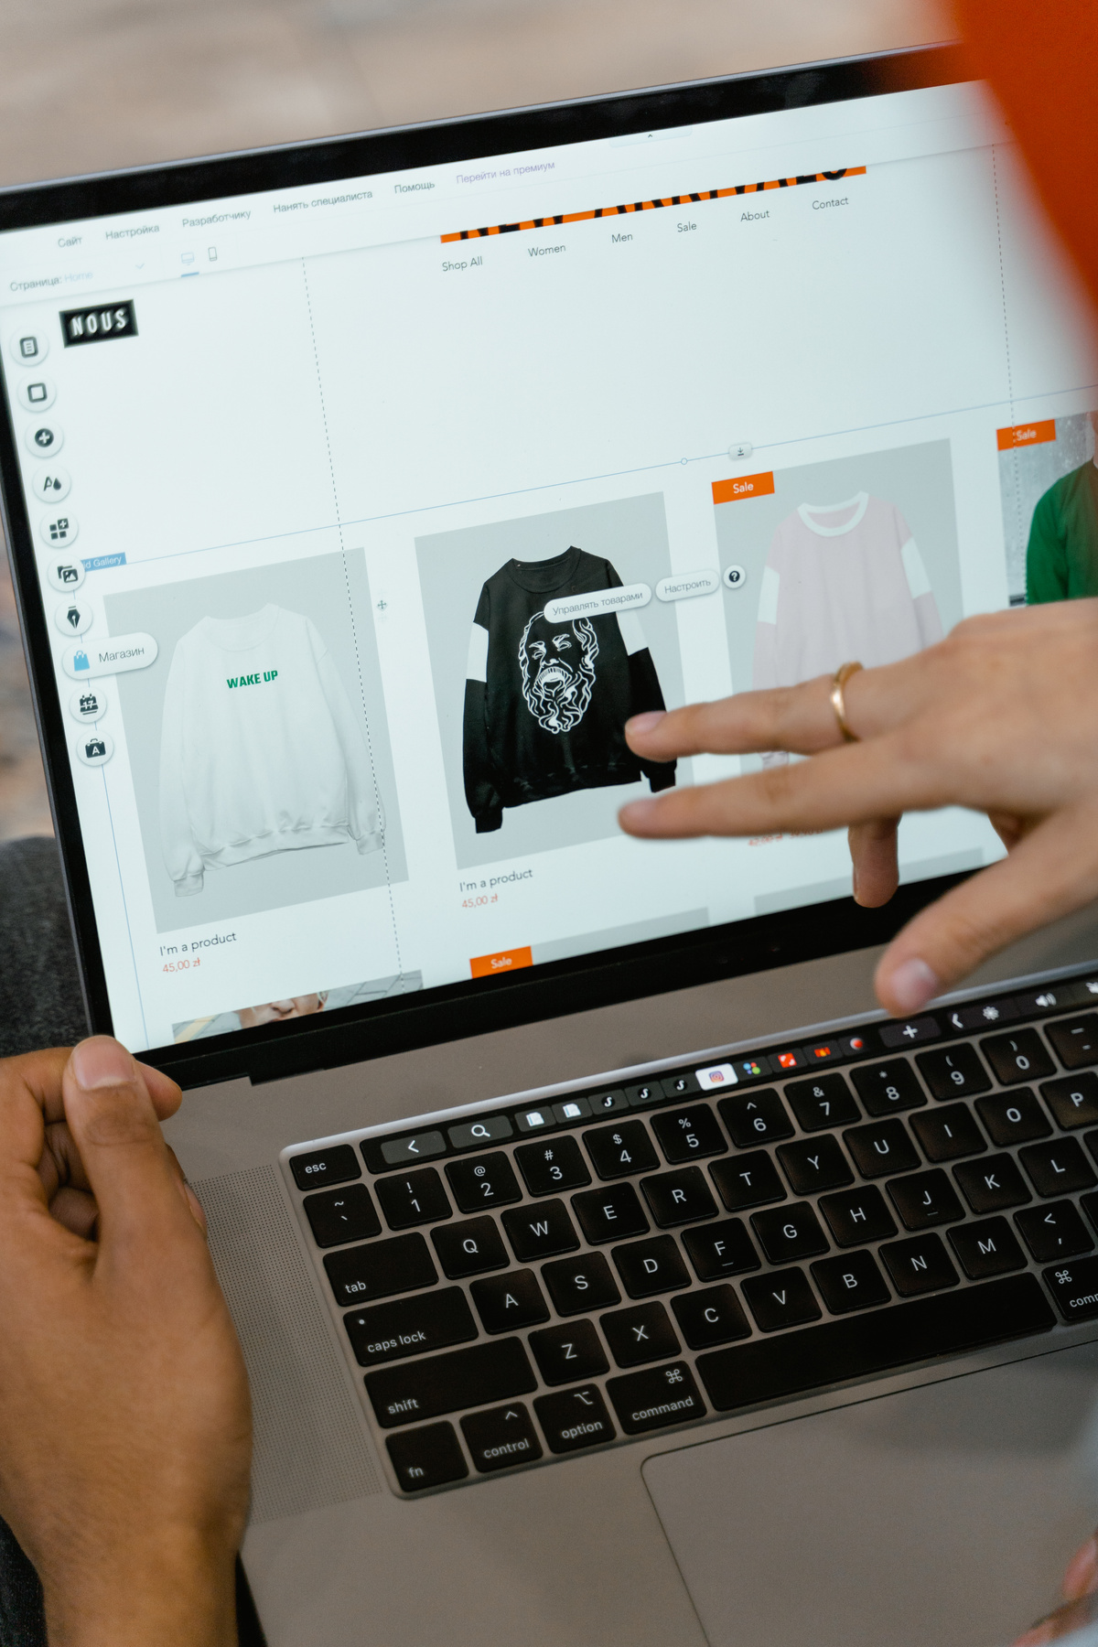

Defining the Task
The task tells AI exactly what you want it to accomplish.
Examples:
Create a landing page.
Generate the HTML structure for this design.
Convert this design into Bootstrap 5.
Make this website responsive.
Improve the navigation bar.
Debug this JavaScript code.
Create a dashboard UI.
A task should be specific.

Slide 16
Providing Context
Context explains what the project is about.
For example:
“I am building a digital services platform where users can
purchase airtime, data, TV subscriptions and other digital services.”
This is much better than simply saying:
“Create a dashboard.”
The AI now understands the type of application it is designing.

Slide 17
Specifying the Target Users
A good prompt can describe who will use the website.
For example:
“The website is designed for Nigerian university students
between the ages of 18 and 30.”
Or:
“The dashboard will be used by business owners who may not
have technical knowledge.”

Slide 18
Specifying the Target Users
This can influence:
Navigation
Language
Typography
Layout
Button labels
Complexity
User experience

Slide 19
Specifying the Technology
Always specify the technology when it matters.
For example:
Use:
- HTML5
- CSS3
- Bootstrap 5
Vanilla JavaScript
Or
Use:
- React
- Vite
- Tailwind CSS
React Router

Slide 20
Specifying the Technology
Or:
Use:
- PHP
- MySQL
- Bootstrap
- JavaScript
Without specifying the technology, AI may choose a framework you don't want.

Slide 21
Specifying the Design Style
Describe the visual style you want.
Examples:
Modern
Professional
Minimal
Elegant
Corporate
Luxury
Playful
Creative
Futuristic
Clean
Tech-focused
You can combine styles:
Create a modern, clean and professional fintech interface.

Slide 22
Specifying Colors
Colors can be included in the prompt.
For example:
Use a blue and white color scheme with dark gray text.
Or more specifically:
Primary color: #2563EB
Secondary color: #0F172A
Background: #F8FAFC
Text: #1E293B
Specific color requirements give AI more control over the final design.

Slide 23
Specifying Typography
You can tell AI what type of typography you want.
Example:
Use a clean sans-serif font.
Use:
- Large bold headings
- Medium-sized subheadings
- Comfortable body text
- Clear line spacing
You can also specify a font:
Use Inter as the primary font.

Slide 24
Describe how the website should be arranged.
For example:
Create a two-column hero section.
Left side:
- Heading
- Description
- CTA buttons
Right side:
- Product illustration
- Floating feature cards
Instead of:
Create a hero section.
The detailed version gives AI a clearer layout.
Specifying Layout

Slide 25
Specifying Website Sections
Tell AI exactly what sections you want.
For example:
Include:
1. Navigation
2. Hero
3. Services
4. Features
5. How It Works
6. Testimonials
7. Pricing
8. FAQ
9. Call-to-action
10. Footer
This reduces the chance that important sections will be forgotten.

Slide 26
Specifying Components
You can ask AI to create specific UI components.
Examples:
Create a responsive navbar.
Create a product card.
Create a pricing card.
Create a login form.
Create a responsive admin sidebar.
Create a modal for confirming transactions.

Slide 27
Specifying User Interactions
A web design prompt should describe how users should interact with the interface.
For example:
“When the user clicks the hamburger icon,
open the mobile navigation menu.
When the menu is open, clicking outside the menu should close it.”
Another example:
“When the user submits the form,
validate all required fields and display appropriate
error messages below the fields.”
This moves the prompt from static design into interactive design.

Slide 28
Specifying Responsive Behavior
Don't simply say:
“Make it responsive.”
Be more specific.
For example:
Desktop:
- Four product cards per row.
Tablet:
- Two product cards per row.
Mobile:
- One product card per row.
The navigation should collapse into a hamburger menu
on screens below 768px.
This gives AI concrete responsive rules.

Slide 29
Specifying Accessibility
Accessibility can also be included in your prompt.
Example:
Follow basic web accessibility best practices.
Requirements:
- Use semantic HTML
- Add alt text to images
- Use labels for form inputs
- Ensure buttons are keyboard accessible
- Maintain sufficient color contrast
- Use meaningful link text
This encourages AI to produce more accessible websites.

Slide 30
Specifying SEO Requirements
You can ask AI to consider SEO.
Example:
Optimize the page structure for SEO.
Requirements:
- Use one H1
- Use logical H2 and H3 headings
- Add a descriptive title
- Add a meta description
- Use semantic HTML
- Add descriptive alt text

Slide 31
Specifying Performance Requirements
You can also tell AI to optimize performance.
Example:
Optimize the website for performance.
Requirements:
- Avoid unnecessary JavaScript
- Use responsive images
- Lazy-load images where appropriate
- Avoid excessive animations
- Keep CSS organized
- Avoid unnecessary external libraries

Slide 32
Specifying Code Structure
When asking AI to generate code, specify how you want it organized.
For example:
Separate the project into:
index.html
css/style.css
js/script.js
images/
Or:
Create separate React components for:
Navbar
Hero
Services
Testimonials
Footer
This makes the generated project easier to maintain.

Slide 33
Specifying Output Format
AI needs to know how you want the result presented.
For example:
Return the result as:
1. HTML
2. CSS
3. JavaScript
Or:
Provide each file separately using code blocks.
Or:
Explain the code first, then provide the complete code.

Slide 34
THANK YOU

